Slide 1
WOW+TRUST: The Keys to Writing Successful Grant and Fellowship Proposals
Devin Sodums
Director, Office of Sponsored and Student Research
2024 - 2025

Slide 2
Grants vs Fellowships – what’s the difference?
GRANTS | FELLOWSHIPS
Awarded to an institution (university) | Awarded to an individual (faculty scholar)
Typically supports a project, program or initiative | Typically supports research for a project
Project occurs where needed | Often at the funder’s location so fellows can be part of a community of scholars
May support a team (faculty, staff, students, subcontractors) and other project expenses | Typically supports one person and sometimes a housing or travel allowance
Line-item budget | Flat amount or percent of salary
GPAF internal review process | FAF internal review process
Notes:
Examples of Grants awarded to Valpo:
NSF
NIH
Lilly Endowment
Indiana Arts Commission
Indiana Academy of Science
Indiana Department of Education
Department of Energy
Indiana Space Grant Consortium
Examples of Fellowships awarded to Valpo:
Massachusetts Historical Society
American Antiquarian Society

Slide 3
Success is WOW+Trust
WOW | TRUST
In-depth knowledge and expertise | Find the fit and follow the instructions
Creative methods or problem-solving | Realistic, reasonable budget
High impact | Complete and accurate application
Qualified team and organization | Project honesty and trustworthiness
Well-written, persuasive | Pieces fit together and make sense
Notes:
First impressions are critical, as one panelist interviewed about their experience being a reviewer said, “The abstract must sell the grant, If I don’t get interested by the first page, the proposal is lost”
As one successful grant writer put it, “My epiphany came when I realized that grant programs do not exist to make me successful, but rather my job is to make those programs successful.”
Use Active voice in the writing, e.g. “ Our aim with this innovative curriculum is to improve the supply of exceptionally skilled paramedics with National Registry certification.”
“This project will provide your grant program with a powerful combination of cutting edge nanoscale science and frontier research in applied geochemistry.”
“Though we launched this large and ambitious program just two years ago, we are gratified by the regional and national awards it has garnered.”

Slide 4
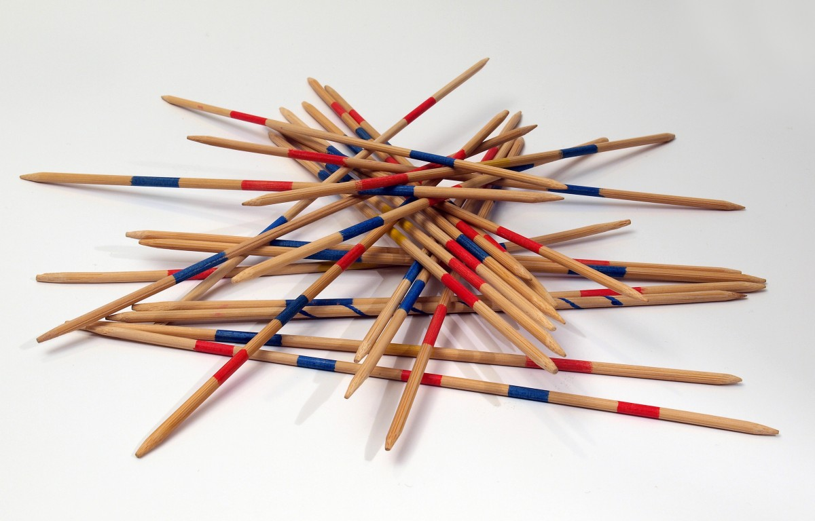
Proposal Writing is a Specific Skill
It takes practice
Start early so you have time to get feedback and refine
Be nimble and flexible
Be patient with yourself, It’s a learning process
Grants/fellowships are competitive, be persistent!
Notes:
Common mistakes:
Writing that is vague or unfocussed
Writing that is too densely academic, or written like a journal paper
Incomplete response to the program announcement
Writer does not understand the state of the field
Project is too ambitious or too global in scope
Research plan is vague, where PI seems to be saying “I know what I’m doing, trust me.”
PI lacks proven competence to do the research

Slide 5
Where/how to Start?
Keep a list of ideas
Start with small Grants
Find a mentor/Listen to advice
Consider being a Co-PI/team member
Convene a multifaceted team, Collaborate!
Learn as much as you can about the funder
Volunteer to be a grant reviewer
Notes:
One optional strategy, but very effective if you have the time and energy is to develop a relationship with the relevant program manager, as this one reviewer said:
As a PI or co-PI you need to have a rela­tionship with the program manager. Your job in writing the proposal is to help the program manager be successful. I really believe that. So if the program manager says, "Look, I want to develop the next XYZ," your job is to help him or her be successful by doing just that. That's the truth. Your job is to help that manager establish that research program. You do it by showing a 2 or 3 page white paper and asking, "How about this, does this fit your program?" It's very impor­tant to strike up a relationship with the program manager in a somewhat person­al way (T. Long, per­sonal communication, 20 May 2004)
Do your homework – check out the agency’s past funded projects, read their mission statement

Slide 6
BEST PRACTICES FOR SUCCESS
Assure your project fits the funder’s priorities
read and follow the instructions
Know your audience and tailor your approach
Clear communication is just as important as content
Plan ahead/Start early
Get the “easy” parts out of the way
Talk with project officers
Submit early
Use reviewers’ comments to improve the next time
Notes:
Characteristics of a good proposal:
Document is neat, well organized, and easy to read
Responsiveness to program announcement, with specific references showing how the proposed project will achieve program goals and objectives
Fresh insight into an important problem
Writing that communicates the enthusiasm and commitment of the researcher
Evidence that the PI knows the field
Convincing preliminary data
Feasible work plan that is supported by an appropriate budget
Use visual illustrations (graphs, charts, photos)
On resubmitting: It’s worth almost assuming you won’t have success on your first submission, and always keep resubmission in mind.
“The big lesson is not to take rejection personally, because when you throw in the social dynamics of the panel, and the large number of proposals they've looked at in a short period of time, it's a crapshoot. Also, remember you're writing a document that most panelists are not going to read-they're going to iook at parts of it, but they won't read it from start to finish-so you better put some eye-catching things in there to hold their attention. (D. Inman, per­sonal communication, 13 May 2004)”

Slide 7
Finding opportunities
Federal government
Grants.gov
Agency websites and e-newsletters
State and local government
Agency websites and e-newsletters
Private foundations/grants for individuals (fellowships, too)
Candid database and newsletters
Professional associations
Networking/word of mouth/general internet searches
Pay attention to the specifics and Eligibility
Funding purposes, exclusions
Match/cost-share requirements
Timeframes
Geographic preferences
Giving history

Slide 8
The Funder’s Perspective
Priorities and timing are set by the Board of Directors or laws/regulations
Desire to make the most impact with their investment
Overwhelming number of applications
Limited funding to share
Their deadlines and guidelines work for them

Slide 9
Grants – Grant Proposal Application Form (GPAF)
The Grant Proposal Approval Form (GPAF) packet must be routed, reviewed, and fully approved BEFORE any grant proposal may be submitted. GPAF form/cover sheet
Conflict of interest (COI) forms for all PIs/Co-PIs and key personnel,
Project overview/narrative,
Project budget spreadsheet,
Budget narrative/justification,
RCR/RECR CITI ethics training certificates (NSF and NIH only),
Off-Campus Safety and Inclusion Plan, if applicable (NSF only), and
Financial COI online training certificates (NIH only)

Slide 10
Grants – Grant Proposal Application Form (GPAF)
Valpo policy requires that the PI allow at least 5 business days before the submission deadline for the internal approval process to be completed. People review the GPAF packet in the order listed on the GPAF form, starting in the PI’s local department.
GPAF FORM

Slide 11
Fellowships – Fellowship Application Form (FAF)
Valpo encourages faculty to apply for fellowships to support their research interests and creative work.
To ensure accurate coordination of salaries and benefits, faculty are required to share information with various internal parties, similar to the internal review process for grants.
This form is also used for travel grants where the PI is only requesting travel support and no funds are requested for any other project or activity.
FAF FORM

Slide 12
WOW+TRUST - resources
The Office of Sponsored and Student Research is here to help!
Devin.Sodums@valpo.edu
ASB 216, Extension 5798
https://www.valpo.edu/sponsored-and-student-research/

