Slide 1
Demystifying Grant BudgetS
Devin Sodums
Director, Office of Sponsored and Student Research
2024 - 2025

Slide 2
What’s the Big deal about budgets?
Bottom line – you are asking for money
Externally with the funder
The budget becomes the financial basis for your grant agreement
IF you are the PI/project manager, make sure funds are spent appropriately
Internally
Budgets let your chair/Supervisor know – in advance – how you might be spending part of your time. They can start planning.
Finance can make sure that the budget is compliant with various rules and regulations
We pay special attention to match/cost-share requirements and indirect costs

Slide 3
Be Clear About Your Project (Without Thinking about Costs)
Your project needs to make sense before your budget can make sense
Clarify the scope of the project
Work to be done
Deliverables to be produced
Timeframe
Team members
Be realistic – don’t overpromise/overcommit
Know what’s allowed
Know where you can be flexible
Budgeting is an iterative process

Slide 4
What do You Need to do the Project?
Possible Line Items
Who – Faculty, staff, and student workers
When – Summer may be different from academic year
How long – Hours worked over what period of time
What do you need – Supplies and equipment
Will anyone be traveling – Conferences, to do the work?
Other things – Consultants, subawards, publications
Make a list, write down your assumptions
Check for consistency with the narrative and instructions

Slide 5
Do Your Research
Talk with colleagues
Be as realistic as possible – get vendor quotes, look at past grants
If a match/cost-share is required, talk (Early) with Department Chairs, Deans, and others about possible sources of match/cost-share funds
Don’t assume that things are the same as last time
Start early so you can let it sit and come back to it
Budgets are plans based on the best information you have at the time – actual spending will be different (and funders know that)

Slide 6
Start Using Numbers
Write down your assumptions/how the numbers are calculated
Develop a baseline scenario
Make incremental changes to that baseline scenario
Pay attention to funding limits/restrictions
Only include match/cost-share if required, aim to hit the required amount
Direct vs indirect costs - Remember indirect/F&A/Overhead, if allowed!
Keep cross-checking against the narrative and the funder’s requirements

Slide 7
Common Types of Expenses
Salaries/course releases
Fringe benefits
Supplies – consumables
Equipment - $5,000+ and 1+ years of useful life
Meals/travel/lodging
Consultants/vendors
Stipends/honoraria
Publications
Indirect costs – federally-negotiated rate or other as/if allowed by the funder
Matching funds (if required)

Slide 8
Use Valpo’s Budget Spreadsheet template
Organized by types of expense
Add rows to include more people, more supplies, etc.
Add columns for more years and for match/cost-share
WE have standard ways to calculate course releases, fringe benefits, indirect costs, etc.
Has formulas to calculate totals
Excel is your friend!

Slide 9
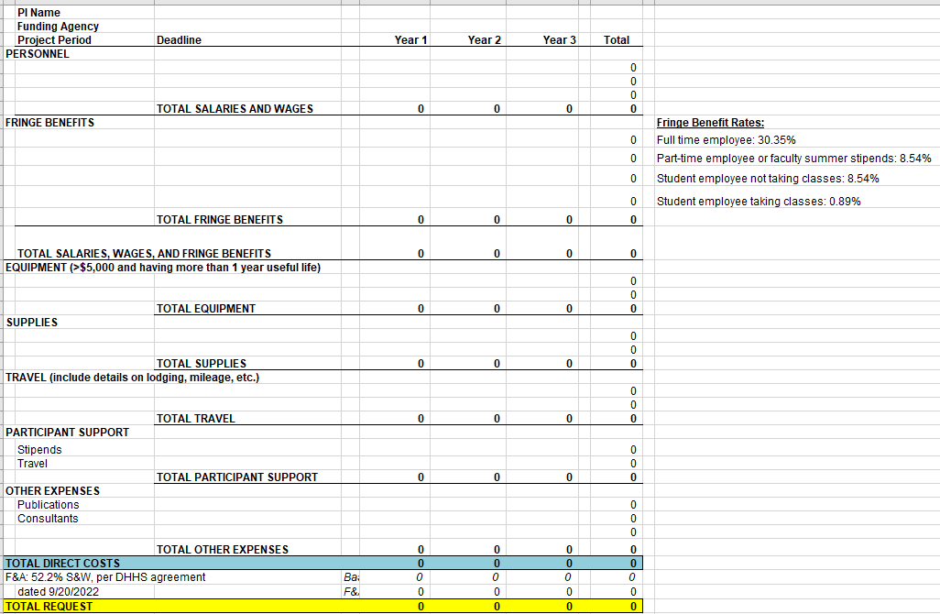
Valpo’s Internal Grant Budget Spreadsheet
Download the current version from:
https://www.valpo.edu/sponsored-and-student-research/sponsored-research/grants-and-fellowships/forms-and-helpful-resources/

Slide 10
Common Budget issues
Forgetting fringe benefits, using the wrong rate
Travel expenses – using approved mileage rate (Found Here - https://www.valpo.edu/travel/forms/
Determining if students involved are paid hourly or via stipend:
If the student can clock in and out for hours worked HR sets up as hourly in the HR/Payroll system
If the student will assist with individual events over a short period of time HR sets up as a student stipend within the HR/Payroll system
If the student is being paid to participate in activities that further their education (over several weeks to months) and is not based on hourly work then Accounts Payable pays the stipend

Slide 11
Budget Justification/Narrative
Required by all funders, in one way or another
Provides the specifics of how your budget is developed
Explain your assumptions and calculations
must match your budget numbers! And your project narrative!
Find a fresh pair of eyes to review

Slide 12
Remember
Budgets MUST be:
Reasonable and realistic
Justified and justifiable
Consistent with funder, Valpo, and
government guidelines
They need NOT be Perfect

Slide 13
More Things to Remember
Internal review process (GPAF) focuses on budget issues – 5+ business days before deadline
Once awarded, it may be possible to re-budget
Instructions, forms, policies, and helpful resources (including the budget template, a sample budget, and sample budget narrative) are available at: https://www.valpo.edu/sponsored-and-student-research/

Slide 14
Budgets – Resources
The Office of Sponsored and Student Research is here to help!
Devin.Sodums@valpo.edu
ASB 216, ext. 5798
https://www.valpo.edu/sponsored-and-student-research

